Slide 1
Sound (and Lua)
By: Ryan, Jai and Andrew

Slide 2
Introduction
Ryan: Hardware, sound capturing and storing
Jai: Software, sound editing
Andrew: Programming language

Slide 3
Hardware

Slide 4
Overview
Sound we hear is analogue wave
Series of compression and rarefactions in air
Ear receives compressions and rarefactions and our brains, which interprets it as sound
Method of capturing sound needs to be made for computers as they use binary
Transfer analogue waves to digital waves. Microphone does this
Dynamic and condenser microphones

Slide 5
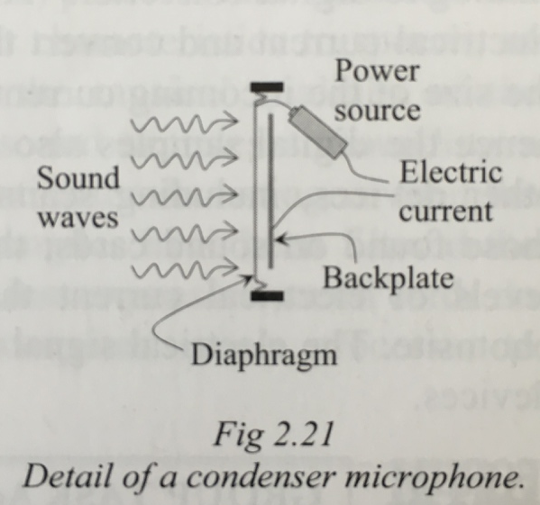
Condenser Microphones
Have diaphragm (A.K.A front plate) and back plate
Diaphragm moves in response to the sound wave
Current flows between the diaphragm and the back plate
Movement of diaphragm alters flow of the electric current
Alternating flow of electric current reflects soundwave
Electric current is the analogue signal of the soundwave
Sent to ADC (analogue to digital converter) which transforms analogue signal into digital data

Slide 6
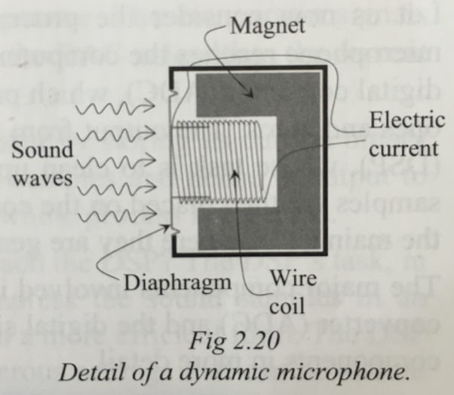
Dynamic Microphone
Three main components; diaphragm, copper coil of wire and magnet
Diaphragm attached to copper coil of wire, which is surrounded by a magnet
Diaphragm and coil move in response to the soundwave
Creates an electric current with the magnetic field from the magnet
Electric current is an analogue signal which is sent to an ADC to transform into digital data

Slide 7
Sound Sampling Devices
There are 5 devices that allow sound sampling to work
ADC: (analogue to digital converter)
DAC: (digital to analogue converter)
SAR: (successive approximation register)
DSP: (digital signal processor)
Comparator

Slide 8
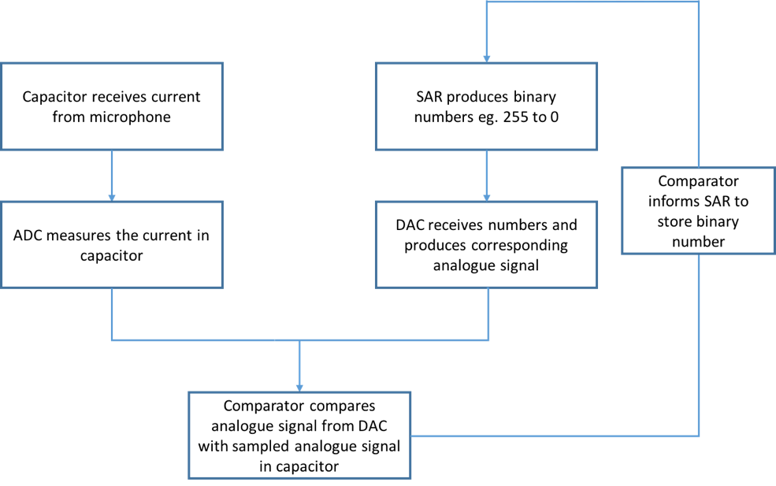
Sound Sampling

Slide 9
Sound Sampling (Cont…)
The number stored by the SAR represents the amplitude of the analogue wave
It is converted into binary data (“1s” and “0s”)
Sampled at thousands of time a second eg at 22,000Hz or 44,100Hz,
Samples sent to DSP

Slide 10
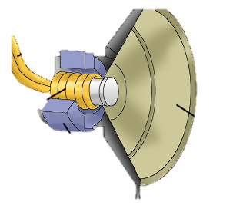
Reproducing Sound
Amplitude captured by sound sampling converted back into electrical current
High amplitude = High current
Low amplitude = Low current
Speaker contains diaphragm connected to a copper coil of wire, which is surrounded by a magnet
Electrical current applied to copper coil of wire causing magnetic field to fluctuate, vibrating copper coil in response to changing magnetic field
Vibration of copper coil causes diaphragm to vibrate causing compressions and rarefactions in air that we hear as sound
Electrical current to copper coil of wire
Coil vibrates in response to changing magnetic field
Diaphragm vibrates as it is attacked to vibrating copper coil
Magnet induces magnetic field around copper coil

Slide 11
Historical Development
Phonograph initially used to capture sound, used in acoustic era (1877 to 1925)
Captured sounds between frequencies of 250Hz and 2,500Hz and only recorded sound at a low quality
Electrical era (1925 to 1945) used electronic microphones, electronic amplifiers and electronic disc cutters
Microphones captured sound more accurately
Captured frequencies between 60Hz and 6,000Hz and also improved sound fidelity

Slide 12
Historical Development (Cont…)
Magnetic era used magnetic tape recorder (1945 to 1975)
Used magnetic strip to record media, read write head induced magnetic fields in the strip to represent sound wave
Greatly improved sound fidelity
Digital era used binary, sound sampled at 44,100Hz (1975 to now)
USBs, CDs and Hard Drives used for storage
Capture sound of high fidelity, captured all frequencies humans can hear 20Hz to 20,000Hz
Extremely portable eg USBs, CDs and iPods

Slide 13
Software

Slide 14

Brief Overview
Sound editing has been present in all of society for decades
Movies, television, games and music require sound editing
Achieved through 2 key ways: analogue editing and digital editing
Examples of digital sound editing software include: Audacity, Wavepad, FL Studio, Adobe Audition
Presentation will be focused on Audacity

Slide 15
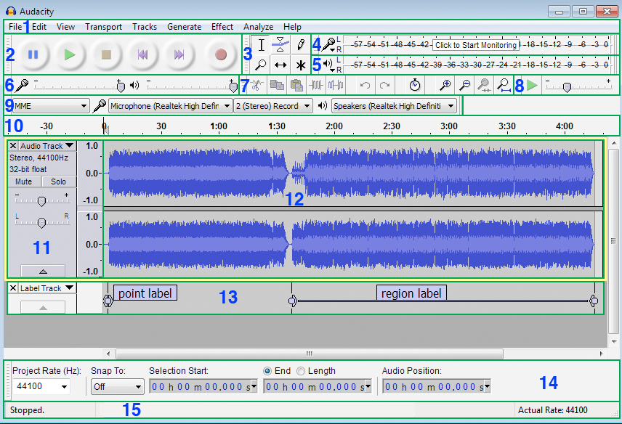
How Audacity Works?
Tools Toolbar
Menu Bar
Recording Meter Toolbar
Transport Toolbar
Playback Meter Toolbar
Mixer Toolbar
Transcription Toolbar
Edit Toolbar
Device Toolbar
Timeline
Track Control Panel
Audio Track
Label Track
Selection Toolbar
Status Bar

Slide 16
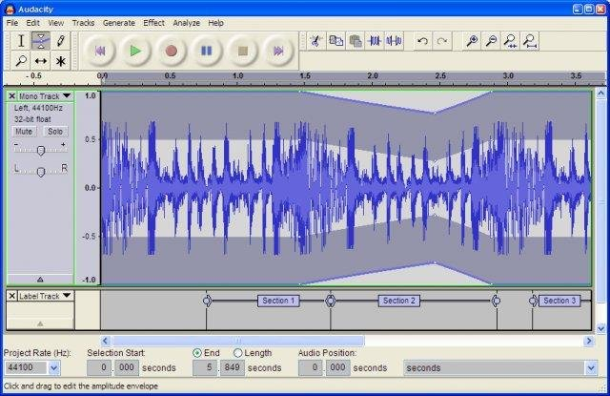
Editing Features of Audacity
Simple editing using the cut, copy and paste buttons
Unlimited sequential undo and redo
Mixing and compiling as many tracks as users need
Use of sound effects

Slide 17
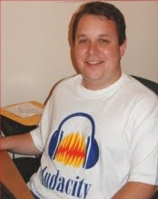
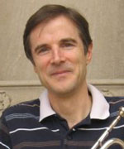
Historical Development
Audacity was first worked on by Dominic Mazzoni and Roger Dannenberg in 1999, as a research project for university
First released on the 28th of May, 2000 as version 0.8
Near the end of 2003, Audacity released the 1.2 series, which introduced hundreds of new features
After the run of the 1.2 series a Beta 1.3 series was released which served as a foundation for the currently running 2.0 series
By version 2.0, Audacity was highly enhanced and improved from its predecessors as it is now smoother, more effective and has more variety for users to work with
Dominic Mazzoni
Roger Dannenberg

Slide 18
Programming Language - Lua
Note - unrelated to the field of sound

Slide 19


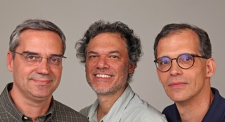
Overview
Cross platform programming language – made to extend software functionality – ie modules
Written by Roberto Ierusalimschy, Luiz Henrique de Figueiredo, and Waldemar Celes
Easy to learn language that is similar to other programming languages
Origins of the programming language name
Winner of the 2011 Game Developer Magazine Front Line Award

Slide 20

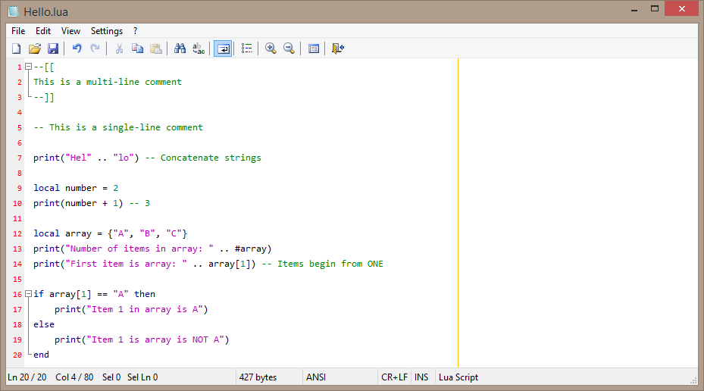
Lua Scripts
Lua scripts can be identified by their file extension (*.lua)

Slide 21
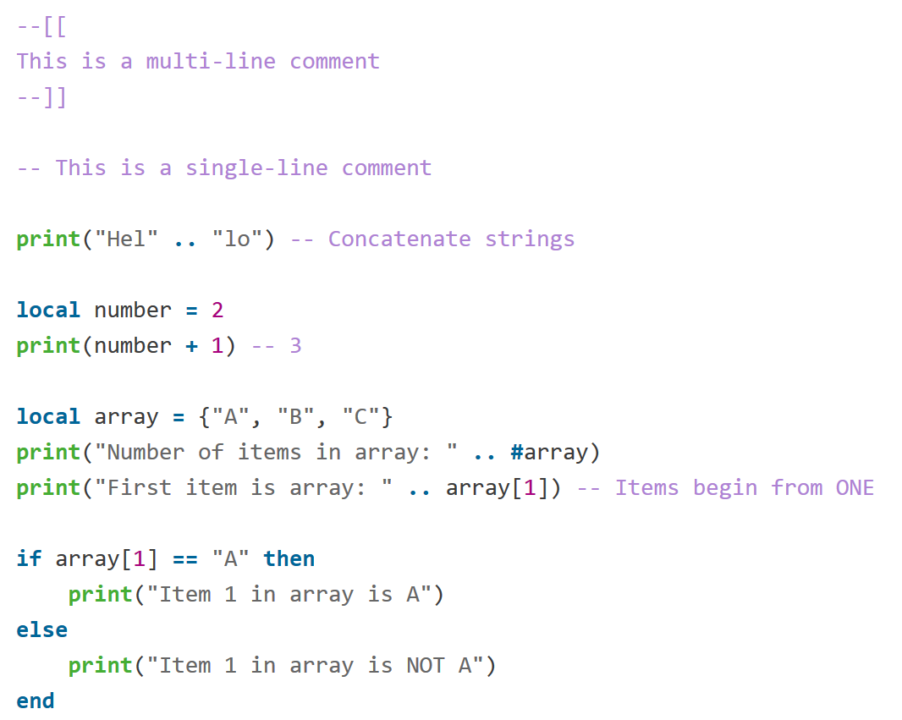
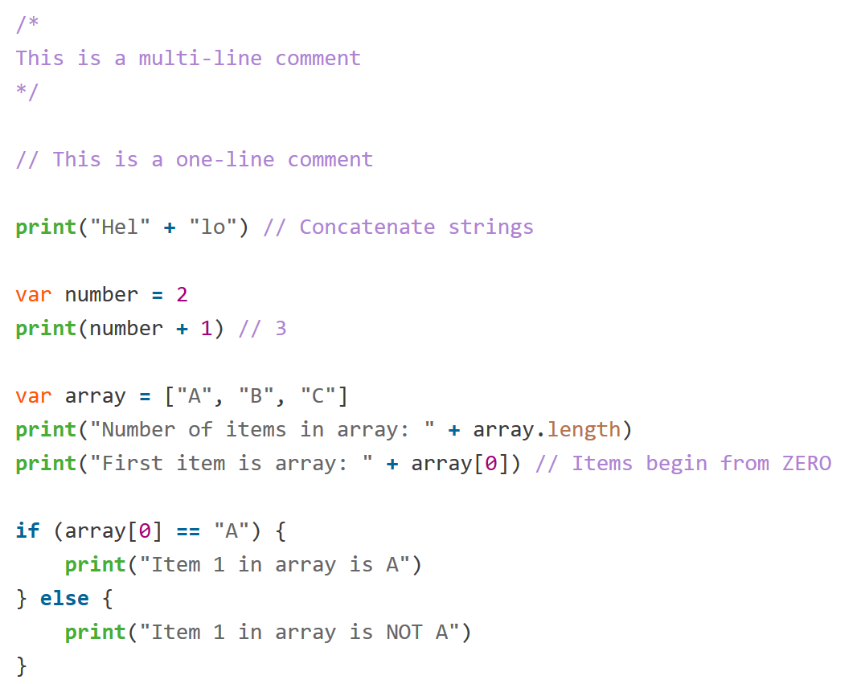
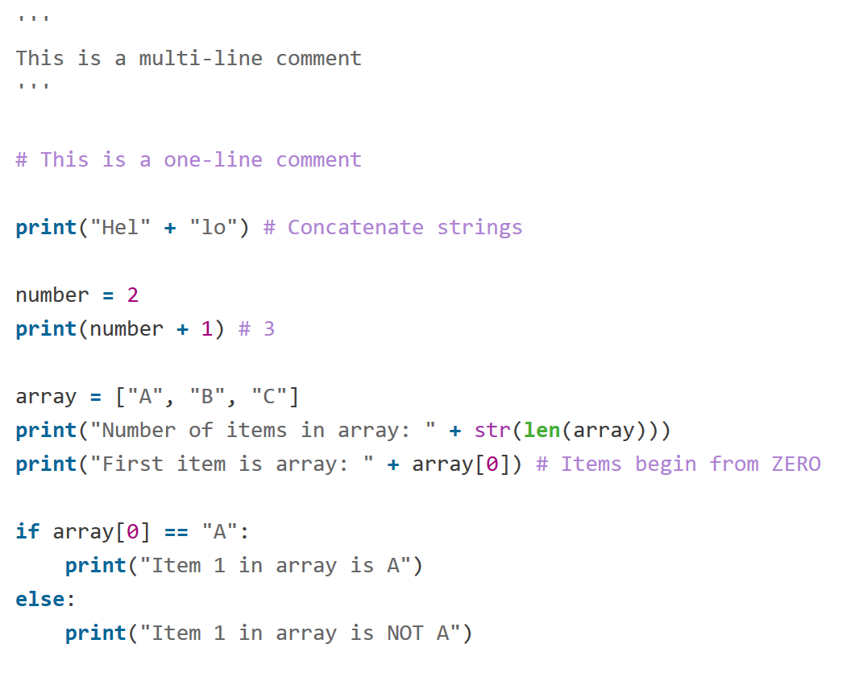
Lua Scripts
Python Version
JavaScript Version
Lua Version

Slide 22
Lua (Basic) Syntax
+ add
- subtract * multiply
/ divide % modulo (remainder) ^ power
== is equal to ~= is not equal to < is less than
> is greater than
<= is less than or equal to >= is greater than or equal to
# length of -- comment (until end of line) --[[ open comment block --]] close comment block
0.5 number
1 number “string” string
‘string’ string
\ escape character
nil undefined / null
and break do else elseif end false for function if in local nil not or repeat return then true until while

Slide 23
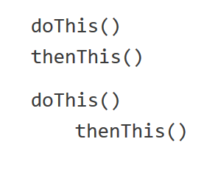

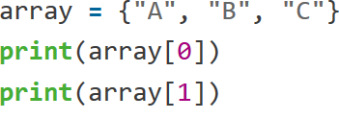
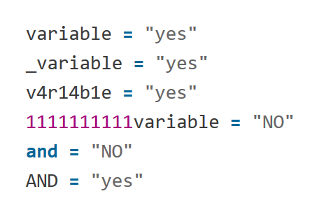


Lua Conventions
Whitespace Significance
Optional Semicolon
1-Based Arrays
✓
✓
✓
✗ nil
✓ A
✓
Intergers and Floats - Numbers
Undefined values – aka ‘nil’
→ 2.5
→ nil

Slide 24
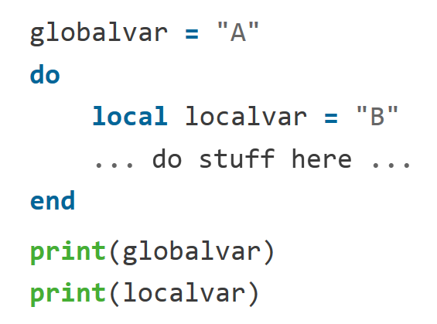

Variables (Identifiers)
Variables are objects which can hold data values.
In Lua, there are global and local variables.
Global variables – accessible everywhere
Local variables – accessible only in its code block
Naming Conventions
Alphanumeric + underscores only (A-Z,a-z,0-9,_)
Does not begin with a digit
Not a Lua keyword (and break do else elseif end repeat return then true … etc)
✓ A
✗ nil
✓
✓
✓
✓

Slide 25
Memory Management
What is memory management? Consideration of the computer’s available resources
Garbage Collection (GC)
Automated memory management process to free up memory by releasing/unregistering variables that are no longer needed
Does not affect global variables, or properties of a table (array/dictionary)
Variable will be unregistered after the script reaches the end of the code block

Slide 26
Why Lua?
As an extension programming language…
Works on many platforms
Short development time
Dynamic compilation (JIT)
Lightweight (small execution overhead)
Simple syntax

Slide 27
History of Lua
Current Version: 5.3.2 (30th Nov 2015)
First Public Version: 1.1 (8th July 1994)
Bug fixes
Device support
Code Execution Improvements

Slide 28
Lua Today – Uses of Lua
VLC Player
TeamSpeak 3
Garry’s Mod
CryEngine
Adobe Lightroom
WoW
LEGO Mindstorms NXT

